Slide 1
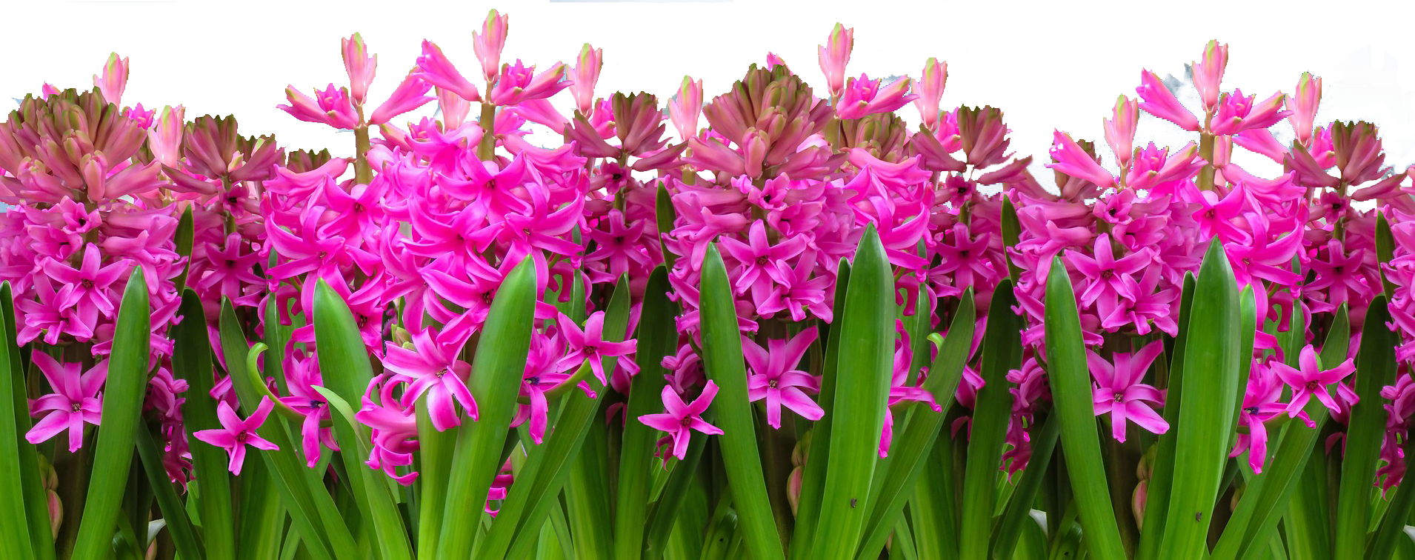
April Showers Bring May Paper Flowers

Slide 2
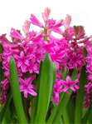
What You Will Learn
By the end of class, you will be able to make a pink paper hyacinth.
You will watch me make one, and then you will make one on your own.
You will also learn:
various materials for making paper flowers
resources for learning how to make paper flowers

Slide 3
Three Levels of Flowers
Beginner – construction paper flowers made in elementary school
Intermediate – tissue paper “roses” made in high school and later for events like parties and bridal shower
Advanced – art paper and professional crepe paper flowers

Slide 4
Beginner Level
Construction Paper Flowers
Easy and quick to make
Requires few materials, skills
Materials are generally inexpensive
Poor archival quality – glue is not designed to last, and construction paper colors will fade

Slide 5
Intermediate Level
Tissue Paper “Roses”
A bit more complex to make
Requires few materials, skills
Materials are generally inexpensive
Poor archival quality – glue is not designed to last, and tissue paper colors will fade. Colors may leach and tissue paper tears easily when wet by glue.

Slide 6
Advanced Level
Art Paper and Professional Crepe Paper Flowers
A bit more complex to make, requires more patience, time, and manual dexterity
Requires more materials and skills
Materials are more expensive, and harder to find
Archival quality may be better, depending on the acid content of the paper and whether it is designed for artists

Slide 7
Advanced Level
Art Paper and Professional Crepe Paper Flowers
Flowers at this level can be quite realistic and have texture along with beautiful colors due to higher-quality materials
Some advanced level flowers are sold in stores on Etsy
The advanced flowers are sometimes marketed for weddings and baby showers

Slide 8
Additionally…
You can also make paper flowers using Origami, the Japanese art of paper folding.
Origami takes special paper, patience, manual dexterity, and practice.

Slide 9
Tools
Beginner | Intermediate | Advanced
Safety or regular scissors | Regular scissors | Regular scissors, scalloped or pinked edge scissors, custom dies, digital rotary cutter like the Cricut
Plastic ruler | Plastic ruler | Plastic or steel ruler
Elmer’s School Glue | Paper glue, string, or wire | Hot glue gun or wire

Slide 10
Examples
Beginner - https://www.youtube.com/watch?v=LFHGsHdY8w4
Intermediate - https://www.youtube.com/watch?v=GXrOvUY5ZF8
Advanced – https://www.youtube.com/watch?v=EuYz3zXBf9Y

Slide 11
Materials and Tools for Today
Paper - colored paper or construction paper – one sheet green for leaves, and one sheet colored for petals
Glue – Elmer’s School Glue
Green plant stake
Additionally, if you try this at home:
Regular scissors
A ruler

Slide 12
Materials and Tools for Today
To save time, we have pre-cut the paper for you. All you will need to do is apply glue and wrap the leaf and petal strips around the top of the plant stake.

Slide 13
Template for Later
Fold line ½” down
3”
height
A. Petal Strip
Cut from colored paper
Not shown to scale, provided
for measurements!
11” width
B. Leaf Strip
Cut from green paper
Not shown to scale, provided
for measurements!
2”
height
3” width

Slide 14
Full Steps to Create the Flower
Gather your materials and tools.
Cut the petal strip – 11” w x 3” h.
Cut the leaf strip – 3” w x 2” h.
Take the petal strip and lengthwise fold the top down 1/2” and press firmly to crease it.
Cut a fringe into the petal strip up as far as the top ½”, using the folded edge at the top as a guide on where to stop cutting:
fringe

Slide 15
Full Steps to Create the Flower
Take hold of the first fringe strip and use your fingers to curl it backwards (left):
Keep curling until you reach the crease at the top.
Curl the remaining fringe strips.
Looking sideways, your petal strip should look something like this:
crease

Slide 16
Full Steps to Create the Flower
Flip the petal strip over so the curled fringe is on the bottom.
Apply a line of glue down the length of the folded petal strip.
Use your fingertip to spread the glue more evenly.
Wipe the glue from your finger(s) with a baby wipe, and dry your fingers if necessary with a paper towel.
Pick up the green stake.

Slide 17
Full Steps to Create the Flower
Carefully pick up the petal strip (watch out for the glue), and starting at the top of the green stake, press the flat folded side (with the glue) of the paper strip against the stake at an angle, turning the stake with one hand, winding and pressing the petal strip down with the other hand.
Wrap down diagonally, overlapping a little, turning the stake as you go. Visualize wrapping a red stripe down a barber pole from the top, but with no “white” space in between turns.
Press the end of the strip firmly against the stake. Put the stake down gently.

Slide 18
Full Steps to Create the Flower
Take the leaf strip and lengthwise fold the top down 1/2” and press firmly to crease it.
Starting left, cut a half sharp peak, then 2 full sharp peaks, then a half sharp peak into the leaf strip up as far as the top ½”, using the folded edge at the top as a guide on where to stop cutting:

Slide 19
Full Steps to Create the Flower
Flip the leaf strip over.
Apply a line of glue down the length of the petal strip.
Use your fingertip to spread the glue more evenly.
Wipe the glue from your finger(s) with a baby wipe, and dry your fingers if necessary with a paper towel.
Pick up the green stake.
Press the end of the leaf strip against the stake with your other hand, and wrap the leaf strip around horizontally this time, turning the stake as you go.

Slide 20
Full Steps to Create the Flower
Press the end of the leaf strip against the stake with your other hand, and wrap the leaf strip around horizontally this time, turning the stake as you go.
Press the end of the strip firmly against the stake. Put the stake down gently.
If needed, use the baby wipes to clean glue off your hands.

Slide 21
Demonstration

Slide 22
Now You Try It

Slide 23
Resources to Learn More
Videos
How to make paper hyacinths - https://www.youtube.com/watch?v=Pp9dStDckNA&feature=youtu.be
ABC Video library – large group of how-to paper flower tutorials – the fuschia video I showed came from this library - https://www.youtube.com/channel/UC8MGdsdoHtenMqtxXALT1yw/videos
Lia Griffith’s site – painted tulips – Lia does high-end paper flowers and has her own line of die cuts at Joann’s for making paper flowers - https://liagriffith.com/pastel-painted-crepe-paper-tulips/
Design Sponge – tutorial on gorgeous paper daffodils - http://www.designsponge.com/2016/03/paper-daffodil-tutorial.html
Artsncraft4u – cherry blossoms and more - https://www.youtube.com/watch?v=dM5tJgvOgv0
Check YouTube and Pinterest – search for paper flowers

Slide 24
Resources to Learn More
Books
Bold and Beautiful Paper Flowers by Chantal Larocque She uses 65 pound card stock for petals, and molds them, cutting the entire shape together. She then layers petal groupings and adds centers.
The Exquisite Book of Paper Flower Transformations by Livia Cetti She uses tissue paper for petals, wire for shape, floral wire and tape for stems, stamens, and Canson green paper for leaves; uses gouache (opaque watercolor) and Rit dye to create variegated colors in the petals, and gouache for speckles on leaves.
100 Simple Paper Flowers by Kelsey Elam She uses tissue paper or crepe paper for petals; tissue paper or card stock for leaves, and wraps her floral wire stems with floral tape.

Slide 25
Supplies
Local – Joann Fabric and Michael’s both have a nice selection of colored paper. Joann’s carries Fiskar’s Paper Edger scissors with pinked and scalloped edges. Both carry floral wire and tape; the floral stakes we used in class came from Michael’s.
Online: Lia Griffith’s shop - https://shop.liagriffith.com/ - Lia’s shop has special tissue paper and crepe paper and paper flower kits. She stocks the special wide crepe paper necessary to make some of the really beautiful high-end paper flowers.

Slide 26
Contact
Website: dixielang.com
Slides: http://dixielang.com/class-handouts/
Email: dixie.lang@ymail.com

Slide 27
Thanks everyone!
Go forth and make flowers, I look forward to seeing what you create.

